Slide 1
Civil Engineers – Shaping the World
16-18 Careers Presentation
Notes:
You can use this slide show to introduce the subject of civil engineering careers to a group of young people aged 16-18. It mirrors the content of our printed publication ‘ICE 16-18 Careers Guide’ which we recommend to hand out to students attending your talk (order your free copies from careers@ice.org.uk).
The slide deck can be downloaded and individual slides can be customised to suit your presentation style and any information relevant to your own career. For example there is a slide where you can add your own profile and talk about your work (please move to the back if not using). You can of course copy this slide to create more space for your own material.
You should not however, change the layout of the ICE brand or change the font style used throughout (arial).
If you plan to use the civil engineer profile slide then please try to connect to the internet in order to be able to play the linked videos.
As you edit the slide deck, we recommend to move any slides you do not wish to use to the end of the slide show by dragging and dropping them – in case you later find them useful.
Please use the 11-16s careers presentation and similarly matching leaflet for GSCE (and equivalent) level students.

Slide 2
Presented by:
Your Name
Your Job Title
Company or additional information

Slide 3
What is civil engineering?
Civil engineers:
Build our houses, schools, hospitals and more
Deliver the transport that moves us around
Provide the water and energy that keeps us alive
Design the smart cities and towns where we'll live in the future
Tackle global environmental problems affecting us all

Slide 4

Shaping our world and transforming lives
Kingfisher and Bullet Train
Engineers redesigned the front of the high-speed Japanese Shinkansen train to mimic the shape of a Kingfisher’s aerodynamic beak.
Forth Bridge
Engineers designed and built this iconic bridge over 100 years ago - still in use today.
ArtScience Museum
Engineers built this stunning modern and eco-friendly building which houses cutting-edge exhibitions.
Virtual Reality (VR)
Civil engineers use virtual reality to assess their designs for flaws and potential improvements.

Slide 5

What is civil engineering?
The Highline, New York
An abandoned raised railway line turned into a park.
Notes:
Engineers faced many challenges constructing the High Line – almost every aspect of creating a typical park is different when you’re building it up to 9m above ground-level!
The park has a ‘keep it wild’ planting scheme and as they sit on a man-made floor – like a green roof – the varieties chosen are easy to look after (although there is also a built-in
watering system).
Many steel rails and other original features were used to reduce costs as well as environmental impact, including a playground built of parts of the original structure covered with a special rubber coating to create a comfortable play surface.
Top facts:
The park is 2.3km long and located on Manhattan’s West Side.
It has become the most popular tourist attraction in New York – 8 million people visit every year and it’s encouraged a massive regeneration of the city.

Slide 6

What is civil engineering?
ArtScience Museum, Singapore
This spectacular eco-friendly building is part of the Marina Bay Sands complex, built on land reclaimed from the sea.
Notes:
The construction has a circular core around which radiate ten ‘fingers’ housing different galleries. Each ‘finger’ gallery space has a large window at the end allowing a lot of natural
light to illuminate the curved spaces within.
The ArtScience Museum conceived by architect Moshe Safdie and designed by engineering company Arup has 21 gallery spaces with a total area of 6,000 square metres. The diverse exhibitions especially focus on connecting art and science through digital technologies and allowing young people to explore the real and digital world in new ways.
Top facts:
The building’s eco-friendly credentials include harvesting rainwater for domestic use which is channelled through the bowllike roof, falling in a spectacular waterfall into a central pond.
The museum has its air conditioning built into the floor to help save energy – by lowering the temperature at the visitor’s height, rather than trying to cool the entire space.

Slide 7
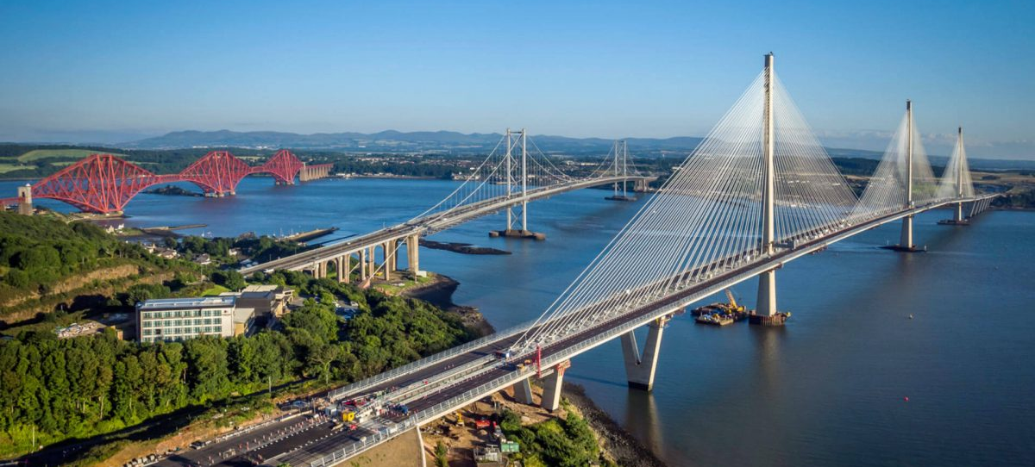
What is civil engineering?
Forth Crossings, Scotland
The three bridges across the River Forth have been a vital part of national infrastructure – providing transport links for people and important industries – for 130 years.
Notes:
The iconic 2,467m long Forth Rail Bridge is a cantilever structure completed in 1890 and is still used by 200 trains a day. It was awarded UNESCO World Heritage site status in 2015.
The first road bridge was built in 1964, replacing a ferry service. A new bridge – the Queensferry Crossing - was built in 2017 to provide more road capacity. Traffic across the two road bridges is managed strategically with heavy vehicles and most car traffic directed across the newer crossing, and buses, bicycles and motorbikes mostly using the old crossing.
Top facts:
The Queensferry Crossing is the longest three-tower, cable-stayed bridge in the world.
The Forth Road Bridge is a 2,500m long suspension bridge. It previously carried 70,000 vehicles - including 7,000 HGVs - and 100,000 people a day.

Slide 8

Could you be a civil engineer?
If you like designing or building, solving problems or improving lives then you’d enjoy a career in civil engineering.
Choosing the right subjects at school or college is important – maths is usually required and physics often too.
Notes:
To become a civil engineer you’ll need to choose the right subjects at school or college. It’s a good idea to check the requirements for any courses you’re interested in, as they can vary a lot.
Maths at A level or Scottish Highers is needed to get onto nearly all civil engineering degree courses. A good grade at GCSE or equivalent will help you secure an apprenticeship.
Physics at A level or Scottish Highers is also asked for by many universities.
Other useful subjects for civil engineering include Geography, Art and Design, Design Technology, Computing, English and some specialist courses such as the Design Engineer Construct! Programme which is offered in some schools.

Slide 9







Top career facts
The average (mean) starting salary is more than £25,000. At the top of the profession they earn over £100,000.
It’s a career which has clear routes through study and qualification.
Studying to become an engineer can open doors to other careers: it keeps your options open!
The UK needs lots more civil engineers.
Civil engineers’ skills are in demand across the world.
Civil engineering regularly features in polls of the top happiest jobs!
Qualified engineers have a high status similar to doctors and lawyers.

Slide 10

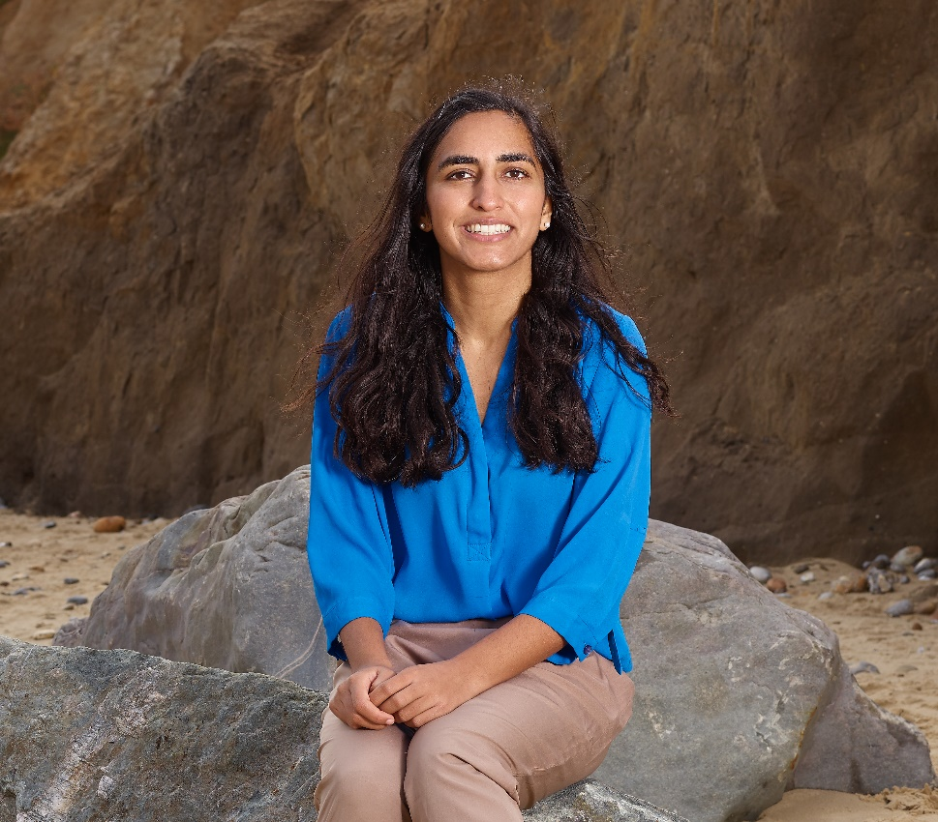
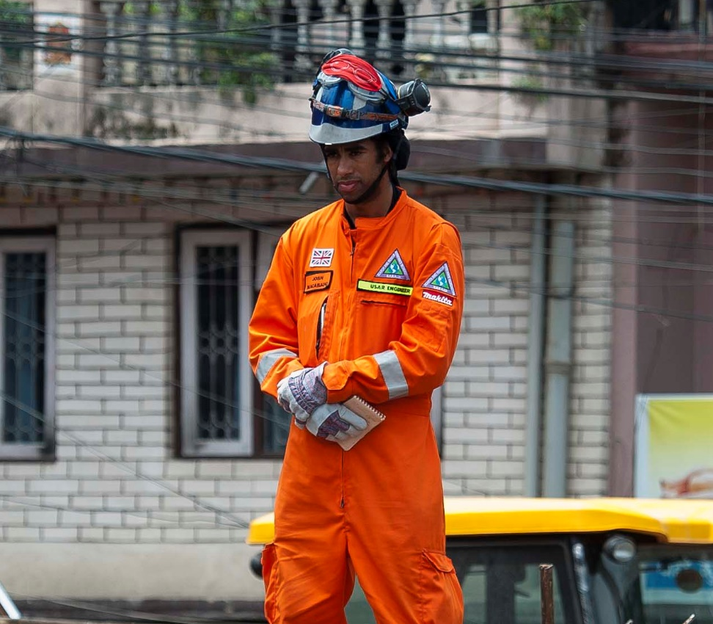
Real-life civil engineers
Ayo Sokale
Hiba Khan
Joshua Macabuag
Notes:
These three profiles of civil engineers can be used to demonstrate and show evidence for the diversity of careers in the profession. Press the ‘play’ buttons to go to online videos of each engineer.
Ayo is a Graduate Civil Engineer with The Environment Agency. Full profile at: https://www.ice.org.uk/what-is-civil-engineering/civil-engineer-profiles/ayo-Sokale
Hiba Khan is a Chartered Civil Engineer with Mott MacDonald who works on water engineering and flood alleviation. Full profile at: https://www.ice.org.uk/what-is-civil-engineering/civil-engineer-profiles/hiba-khan
Joshua Macabuag is a disaster risk specialist who works for the World Bank and does modelling for future and current disasters. He is also a volunteer search and rescue engineer helping to save lives. Full profile at: https://www.ice.org.uk/what-is-civil-engineering/civil-engineer-profiles/joshua-macabuag

Slide 11

About me – Your Name
My top career facts
I studied at…
I am a … engineer which means I…
My favourite project so far is…
I love civil engineering because…
Notes:
If you choose to present yourself as an example of a real-life civil engineer then this is your slide to customise!
It's a great way to connect with your audience (plus you’re guaranteed to know the answers to their questions in relation to your own career!).
To change the image to a photo of yourself, or one of your projects, right click on the holding image and select change picture.
You can change the copy on the right to whatever you want. The suggested copy would provide a quick overview of how and why you got into civil engineering.
You can right click and duplicate the slide in the LH slide-sorter column if you want to add another about yourself or your work.
Don’t forget to change the slide title too!

Slide 12

How to become a civil engineer
There are many different routes.
You can study at university (BEng or MEng).
You can get straight to work with an apprenticeship – combining study and hands-on experience.
You can do a vocational course (e.g. BTEC or HND).
Notes:
Studying at university can give you a fast-track route to Chartered Engineer status and the top jobs in the profession. For more info see ice.org.uk/beacivilengineer
A vocational course (such as BTEC or HND) combines study with ‘hands on’ experience and can give you a fast-track to qualified Engineering Technician status. If you get taken on as an apprentice by a company you’ll get paid as well as be given time off each week to learn. It’s possible to progress from this role to become a Civil Engineer with enough job experience.
There are more ways to study and enter industry than ever before – including starting while still at school (foundation apprenticeships) and working and getting a degree at the same time (degree or graduate apprenticeships). For more info see ice.org.uk/apprentices

Slide 13

Support to become a civil engineer
The Institution of Civil Engineers (ICE) offers support for studies
ICE QUEST Scholarships worth up to £8000 are awarded to up to 100 students.
Free student membership to the institution for the length of your course.
Notes:
ICE QUEST scholarships are available for both vocational and university routes.
ICE QUEST Undergraduate Scholarship offers £8000 over the course of study and must be applied for the April before going to university. It also links you with a company sponsor who will provide work placements and could offer you full time employment on graduation.
ICE Technician scholarship offers up to £1000 to those studying and working on an apprenticeship or vocational route.
Free ICE student membership gives you a host of benefits including opportunities to network with industry professionals and other students, knowledge resources to help with your studies, updates on the latest industry news and the chance to start preparing early for gaining your professional qualification (CEng, IEng etc). As a student member you can also apply for ICE QUEST student travel award which gives up to £1,500 for a civil engineering related trip – such as volunteering for a development charity e.g. Bridges to Prosperity.

Slide 14
Support to become a civil engineer
The Institution of Civil Engineers (ICE) offers support for studies
ICE QUEST Scholarships worth up to £8000 are awarded to up to 100 students.
Free student membership to the institution for the length of your course.
Notes:
ICE QUEST scholarships are available for both vocational and university routes.
ICE QUEST Undergraduate Scholarship offers £8000 over the course of study and must be applied for the April before going to university. It also links you with a company sponsor who will provide work placements and could offer you full time employment on graduation.
ICE Technician scholarship offers up to £1000 to those studying and working on an apprenticeship or vocational route.
Free ICE student membership gives you a host of benefits including opportunities to network with industry professionals and other students, knowledge resources to help with your studies, updates on the latest industry news and the chance to start preparing early for gaining your professional qualification (CEng, IEng etc). As a student member you can also apply for ICE QUEST student travel award which gives up to £1,500 for a civil engineering related trip – such as volunteering for a development charity e.g. Bridges to Prosperity.

Slide 15
Find out more about civil engineering careers: ice.org.uk/wice

