Slide 1
Final year student presentation
Audience and version:
Final-year civil engineering students
UK focus
Approx 30 min presentation. Can then be supplemented with further info as required (eg more info on professional qualification process)
Mini brief:
Primary objectives
Encourage final year students to upgrade to graduate membership (GMICE) upon graduating
Motivate to progress to become professionally qualified with the ICE
Highlight the support available to help progress to professional qualification
Notes:
Delete this slide before presenting.

Slide 2



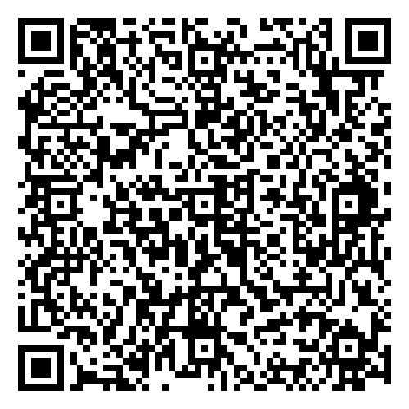
Progress with ICE graduate membership
[Your name]
Notes:
INTRO SLIDE
Speaker notes are included throughout as a guide. Bring these to life by sharing recent or local examples, examples from your experience or other ICE member stories.
*PRESENTER NOTE: update presenter name on slide*
Introduction
Today we are going to focus on:
Why and how to transfer onto graduate membership
Becoming professionally qualified and why it is so important to your career
What you can do now to start your progress towards professional qualification
How ICE will support you throughout your career

Slide 3

The Institution of Civil Engineers
Advance your career with the world’s leading civil engineering institution
Globally recognised professional qualifications
Unrivalled support and guidance
Lifelong learning and industry insight
95,000 members in over 160 countries
Notes:
TOPIC: INTRODUCING ICE / WHY ICE / HOW ICE CAN SUPPORT YOU
So you’re about to start a career in civil engineering – how can the ICE support you?
Top level benefits of being a member of the ICE
With over 200 years at the forefront of industry, the ICE has empowered thousands of civil engineers to reach their highest potential.
We will do the same for you.
What you do each day helps to transform lives.
As a member we’ll support you throughout your career and help you to realise your potential as a civil engineer:
-You become part of our global community of more than 95,000 members in over 160 countries around the world. You’ll have lots of opportunities to meet other members and learn from them at local ICE events
-You can access a wealth of knowledge content and resources to help you develop as a civil engineer
-We will support you to achieve professional qualification – demonstrate your status as a Chartered or Incorporated Engineer, or Engineering Technician
This will all help you to develop, progress and have a successful career.

Slide 4




The ICE is your career partner
Gain experience, develop and pass a Professional Review
Professionally qualified member
Graduate Member
ice.org.uk/graduates
Student Member
EngTech MICE
IEng MICE
CEng MICE
GMICE
Notes:
TOPIC: TRANSFERING ONTO GRADUATE MEMBERSHIP
As you are an ICE Student Member and now completing your studies, the next step is to transfer and become a Graduate Member (GMICE).
You will need to actively change your membership to graduate membership, if you join by 30 September of the year you graduate, GMICE is free for the rest of that calendar year.
If you haven’t been a Student Member – you can still join now at ice.org.uk/students (speaker: assuming they haven’t yet graduated)
When you complete your studies you can upgrade to graduate membership
You will then be entitled to use GMICE postnominals after your name which enhances your CV and is great for job applications
How to transfer onto graduate membership
To transfer onto graduate membership, you will need to provide us with proof that you have completed your course. You don’t need to wait until after a graduation ceremony.
There are three documents the ICE will accept as proof of your graduation:
Graduation certificate
Certified transcript
Letter from University
The next step will be to start formally recording your professional experience and learning – or initial professional development (IPD) and continuing professional development (CPD). You might already have started this while at the University on placements or with summer work experience.
It will take a few years but once you have enough experience you will complete your IPD and apply to sit a professional review to get professionally qualified and that can be an EngTech MICE, IEng MICE or CEng MICE.
*If you join by 30 September of the year you graduate, GMICE is free for the rest of that calendar year.

Slide 5
ICE professional qualifications and membership grades
Engineering Technician, Incorporated and Chartered Engineer
Graduate Member
Engineering Technician,
Civil & Infrastructure Engineer Member
Fellow
  GMICE
  EngTech MICE
  IEng MICE
  CEng MICE
  EngTech FICE
  IEng FICE
  CEng FICE
Notes:
TOPIC: PROFESSIONAL QUALIFICATIONS AND ICE MEMBERSHIP GRADES
Graduate Member - when you complete your studies, you can join as a Graduate Member (GMICE) to progress your career and accelerate your path towards becoming a professionally qualified civil or infrastructure engineer.
PROFESSIONAL QUALIFICATIONS
One of the key reasons people join the ICE is to become professionally qualified - whether as an Engineering Technician (EngTech MICE), Incorporated (IEng MICE) or Chartered (CEng MICE) Civil or Infrastructure Engineer.
Achieving Engineering Technician, Incorporated or Chartered Engineer status commands respect and gives you international recognition for your knowledge, ability and skills.
You can become EngTech, IEng & CEng MICE as a civil engineer or as an infrastructure engineer.
The difference between a civil and infrastructure engineer comes down to what scientific or engineering principles you are using.
For a civil engineer you are using one of the following 4 principles:
Structures
Hydraulics
Geotechnics
Materials
As an infrastructure engineer you may be working alongside civil engineers but you could be using principles more relevant to:
Chemical engineering
Mechanical engineering
Digital engineering
Electrical engineering
Environmental engineering
Just to name a few.
Engineering Technician - professional qualification such as EngTech MICE could be the ideal option if you work as a BIM manager, CAD technician, project manager or a site engineer. EngTech MICE can lead on to IEng & CEng but is an excellent achievement and highly respected qualification in its own right.
Incorporated Engineer – it is expected that you will have around 3 or 4 years of experience to become professionally qualified at the Incorporated Engineer level but this can vary depending on the experience you are gaining at work. At IEng level you will need to provide evidence for 27 out of the 35 parts of the attributes for CEng level. At this level you may be assisting more senior engineers on projects and tasks.
Chartered Engineer - it is expected that you will have around 4 or 5 years of experience to become professionally qualified at Chartered engineer level but this can vary depending on the experience you are gaining at work. At CEng level you will need to provide evidence against all 35 parts of the attributes. At this level you will be showcasing your leadership skills and you will be the one making judgement calls on projects.
Fellow - is the highest grade of membership and recognises the significant contribution you’ve made to industry and society. It shines a light on you and your achievements as a leader.

Slide 6
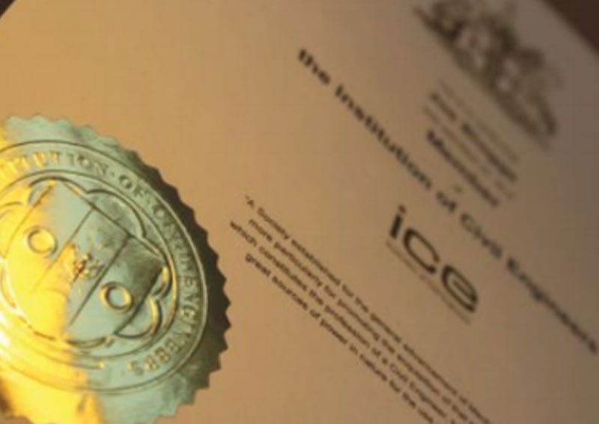
Benefits of professional qualification
Engineering Technician, Incorporated and Chartered Engineer
Increased status
Professional recognition
Earn more money
Valued by employers
Greater career prospects
Global passport
Notes:
TOPIC: BENEFITS OF PROFESSIONAL QUALIFICATION
Benefits of professional qualification
Letters after your name are a mark of excellence:
Increase your professional status
Really valued by employers – will enhance your career prospects and the credibility of your employer
(recent survey highlighted a £9k salary premium for professionally qualified engineers, across all engineering sectors, more at https://www.theengineer.co.uk/content/salary-report/the-engineer-salary-survey-2026)
Internationally-recognised, so could open up opportunities to work around the world
Many members gain a real sense of pride and personal fulfilment having achieved qualification – it helps them be better engineers or technicians and rise to the challenge of shaping the world around them.

Slide 7


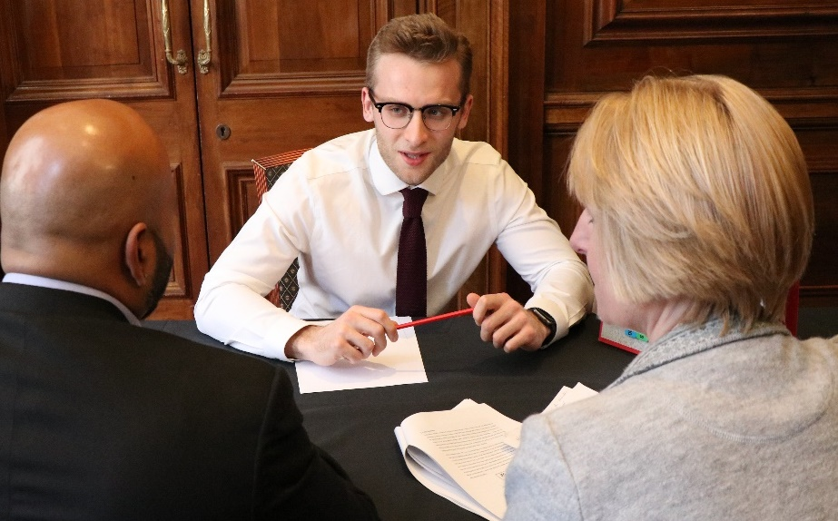
Routes to professional qualification
2.Initial Professional Development (IPD)
1.Academic qualifications
3.Professional Review
Is your qualification accredited?
Check here:
• Accredited Course Search tool
• Academic Assessment
Gain professional experience and measure it with help from an ICE Mentor
• Company Approved Training Scheme
• Mentor Supported Training
• Presentation
• Interview on report
• Communication Task (not required for EngTech)
Notes:
TOPIC: ROUTES TO PROFESSIONAL QUALIFICATION
There are 3 stages to becoming professionally qualified:
Getting your academic qualification
Undertaking initial professional development otherwise known as work experience
Sitting a professional review
Academic qualifications
There are some ways to check your academic base eligibility:
Accredited Course Search Tool – is our course database which contains details on a vast number of undergraduate and masters courses from around the world. It will be able to tell you whether or not your qualification is accredited by the Engineering Council and therefore eligible for professionally qualified membership. (www.ice.org.uk/coursesearch)
Academic Assessment - if your course isn't on the database or you don't have the qualifications to automatically apply for a particular grade of ICE membership or Engineering Council registration, you'll need an Academic Assessment. (https://www.ice.org.uk/your-career/professional-qualification-support/getting-professionally-qualified/academic-assessment)
Work experience
You will also need to develop the skills, knowledge and practical experience required for professional qualification. The ICE calls this your Initial Professional Development (IPD). The ICE and your employer offer lots of support to help you on your journey to professional qualification, as you record and assess the experience you gain. You also need to record Continuing Professional Development (CPD).
(No formal IPD needed for EngTech)
Professional Review
Once you’ve gained the skills, knowledge and experience you need to complete your initial professional development, you’ll need to pass a Professional Review. This includes a presentation and an interview with two experienced civil engineers or technicians. If you are applying for IEng or CEng you’ll also need to do a communication task.

Slide 8


2. Initial Professional Development
ICE training scheme
OR
ICE mentor supported training
Mentored by a Supervising Civil Engineer within your company
External Mentor approved by the ICE
Record your professional experience on IPD Online + CPD Records
Notes:
TOPIC: INITIAL PROFESSIONAL DEVELOPMENT (IPD)
Our team and your future employer will offer lots of support to help you gain the skills and experience you need to complete your Initial Professional Development (IPD) and to help you achieve your goal.
There are different options for completing your IPD:
ICE training scheme
Mentor supported training
The ICE training scheme and Mentor supported training use our IPD online system, this lets you progressively submit your experience and enables your supporting engineers to sign off your evidence if you meet the requirements of that attribute.
You’ll log evidence which is then monitored, and progressively signed off by your Supervising Civil Engineer, or Delegated Engineer when you are on an ICE training scheme or by your mentor when you are using mentor supported training.
Both require you to record Annual appraisals and when you have met and achieved the required skills and abilities an IPD completion.
As your experience grows, the level of responsibility that you will record will increase and you'll find that you'll be able to sign off your examples at increasing levels. You'll need to get to the highest level in all of the attributes in order to complete your IPD.
The ICE training scheme is run by ICE-approved employers. You can check if your potential employer has an ICE training scheme in place by searching in our approved employers database on our website.
Following the ICE Training Scheme is the most effective way to get the work-based experience and support you need to complete your initial professional development and become professionally qualified, your future employer will assign you with a Supervising Civil Engineer (SCE) and may also appoint a Delegated Engineer (DE) to support and guide you throughout the programme.
The mentor supported training route is very similar to the ICE training scheme and should be used by those whose employers don't have a training scheme in place.
It is a structured programme to support your development as a civil engineer and help you to progress to professional qualification. It will help you get the work-based experience and support you need to complete your initial professional development and become professionally qualified
You will be supported throughout by an experienced mentor
The mentor could be someone at your future employer, or another employer. If you need help finding a mentor you could try our online mentor-matching platform (ice.org.uk/mentoring), or get in touch with us. Your mentor will need to be approved by the ICE
You will need to find a mentor before you register with IPD Online and enrol on mentor-supported training

Slide 9
How to measure your experience:
7 ICE Attributes
1. Understanding and Practical Application of Engineering
2. Management and Leadership
3. Commercial Ability
4. Health, Safety and Welfare
5. Sustainable Development
6. Interpersonal Skills and Communication
7. Professional Commitment
Notes:
TOPIC: ICE ATTRIBUTES
To become professionally qualified, you will need to provide evidence against the 7 ICE attributes.
These are:
Understanding and practical application of engineering
Management and leadership
Commercial ability
Health, safety and welfare
Sustainable development
Interpersonal skills and communication
Professional commitment

Slide 10
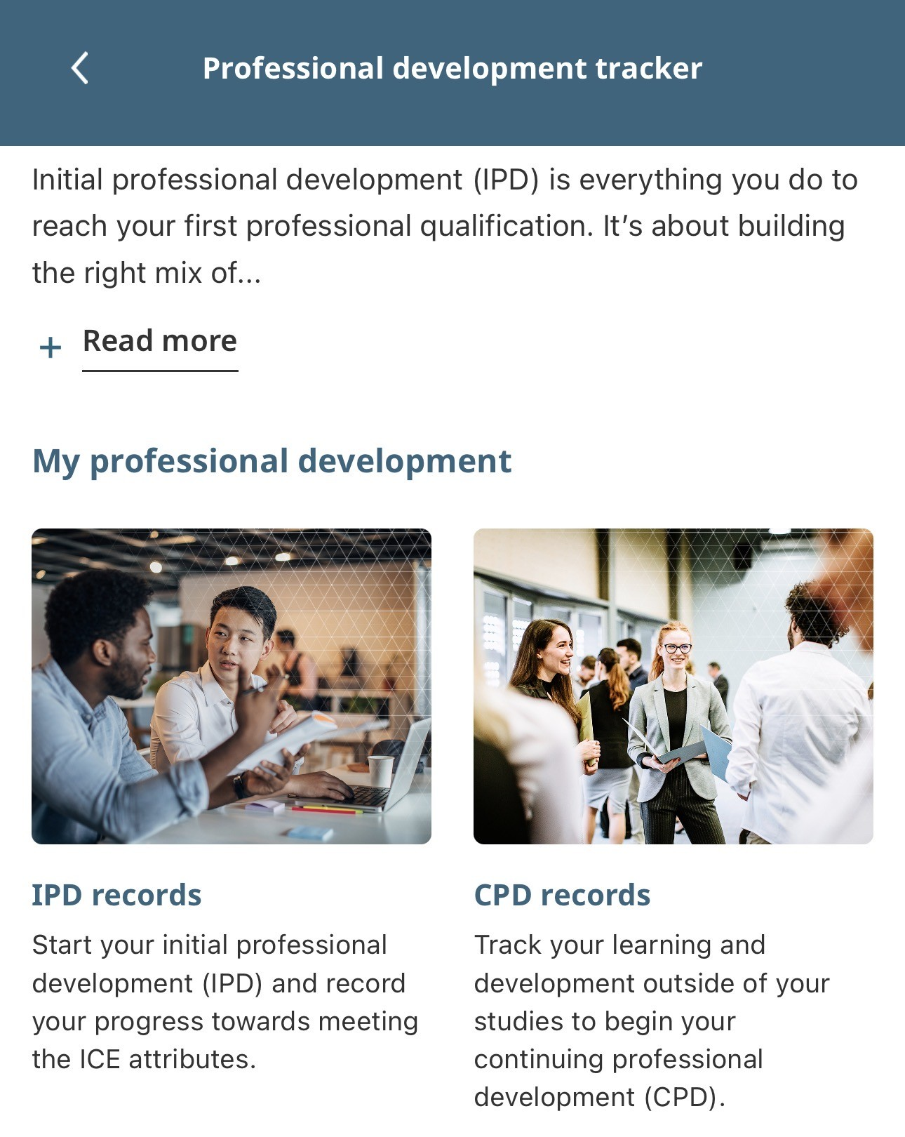
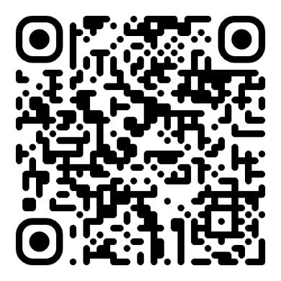
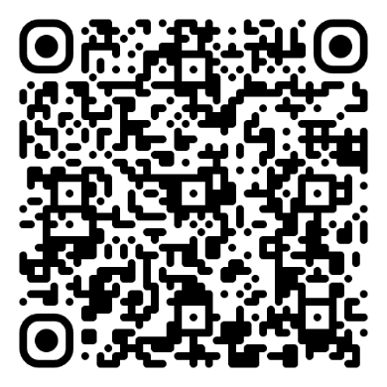
Make your experience count: record it
ICE Careers app – Tracker tool:
It all counts towards your progress to professional qualification:
Summer jobs
Volunteering projects
Placements
Student body roles
Casual work
iOS
Android
Download the ICE Careers app to record your experience on the Tracker tool. Or download and record your experience using the Attribute Achievement form.
Notes:
TOPIC: RECORDING YOUR EXPERIENCE
If you have gained work experience during your studies, you can record it and gain a head start on your journey to professional qualification with the ICE.
If you have had a regular placement with a civil engineering employer, you probably have more.
ICE Careers app – Tracker tool
Download the ICE Careers app and begin recording your initial professional development (IPD) and continuing professional development (CPD) using the Tracker tool.
Attribute Achievement form
You can also record your experience using the Attribute Achievement form available for download on the ICE website linked on this slide.
Include bullet points under each attribute.
If you do not have evidence for each attribute now, don’t worry. As you gain more experience, you will gain more evidence for each of the attributes.

Slide 11
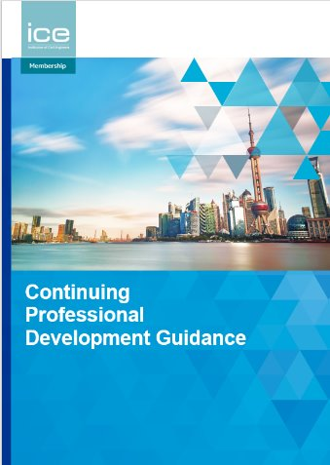
Continuing Professional
Development (CPD)
Continuing Professional Development (CPD) is how you develop your skills, knowledge and experience throughout your career.
You need to have a plan for your CPD and keep a record of your learning activities.
CPD has two parts:
Development action plan (DAP)
Personal development record (PDR)
Notes:
TOPIC: CONTINUING PROFESSIONAL DEVELOPMENT (CPD)
Continuing Professional Development (CPD) is how you develop your skills knowledge and experience throughout your career.
It is self-directed and driven by you for your current and future roles.
ICE requires its members to plan and record their CPD.
CPD has 2 parts:
Development action plan (DAP) - updated once a year
Personal development record (PDR) - updated regularly to capture learning
There are templates for the development action plan (DAP) and personal development record (PDR) in Appendices A & B in the CPD guidance document. You can copy these into Word or Excel and use these for your records.
It should be planned, evaluated and assessed and it will help you set development goals and objectives for your future.

Slide 12
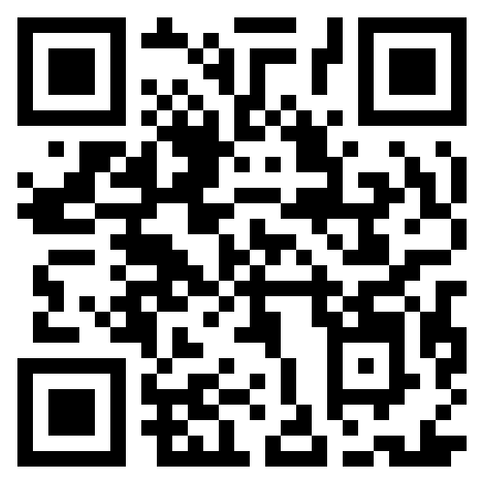
Professional qualification: next steps
UPGRADE
to graduate membership when you complete your studies.
RECORD YOUR EXPERIENCE
Assessed by a Mentor.
COMPLETE YOUR TRAINING
Notes:
TOPIC: NEXT STEPS
*PRESENTER NOTE: recommend focus on the 3 x immediate actions – what final year students should aim to do to get started on their journey to achieving professional qualification*
Once you have a training agreement or mentor support you’ll access IPD online at ice.org.uk/myice
Once you start using IPD online to record your professional experience, your SCE, DE or mentor will review and assess that experience and you are now building your knowledge experience and abilities towards completing your IPD and applying for your professional review.
Ask your employer questions
If you have had a regular placement with a civil engineering employer, it is important to ask them questions to help support your journey towards professional qualification.
You can them questions such as:
Is there a company training scheme?
If not, is there an ICE qualified person who can be your mentor?
While many employers will be able to support you with finding a mentor. If not, the following resources can help your search.
ICE’s mentor-matching platform
ice.org.uk/mentoring
Or contact ICE’s Membership Support Centre:
membership@ice.org.uk

Slide 13

Reasons to upgrade to graduate membership
ICE Training Scheme or mentor-supported training
IPD Online
ICE Knowledge Hub
ICE Rewards
Learning and development resources
Local events
Civil Engineering Journal
Industry updates
ICE Benevolent Fund
And more...
Notes:
TOPIC: REASONS TO UPGRADE TO ICE GRADUATE MEMBERSHIP
A quick overview of the benefits of ICE graduate membership.
*PRESENTER NOTE: Reading detail of every bullet may not be very engaging for the audience - suggest highlight the first two and encourage them to find out about the others online. Have included brief details on all bullets in case the audience asks about them*
ICE Training Scheme /Mentor Supported Training – emphasise these, how they support their development
IPD Online – emphasise this too
ICE Rewards: discounts and special offers on leading brands and retailers. Includes deals on cinema tickets, gym membership, mobile phones to travel and holidays
Local events: local team, and volunteer members, organise a host of events on a range of topics. Great chance to learn more about the industry and grow your network with other grads and more experienced engineers
NCE digital: industry publication. Digital access included as part of your membership
ICE Knowledge Hub: online portal with a wealth of knowledge content to help you learn and develop
Other online resources: content from our library, expert thought leadership all available on our website
Civil Engineering journal – ICE’s flagship journal with articles on a range of civil engineering topics; receive digital edition
ICE Benevolent Fund: *note there are eligibility criteria for financial support, details on Ben Fund website. Other wellbeing support – online portal, helpline, webinars – is available to all
Make the most of your membership

Slide 14


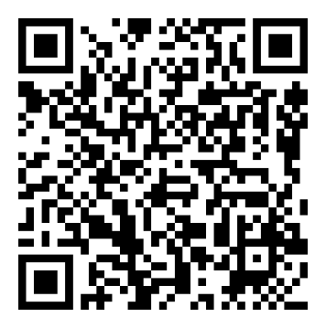
Your guide to getting ahead
ICE Careers app
Careers talks
Get career ready. Explore our careers guide, track your development, discover ICE student events and more. Download the app.
Get industry insight and practical tips from recent graduates through our webinar series.
iOS
Android
Notes:
TOPIC: YOUR GUIDE TO GETTING AHEAD
Stay ahead of the curve by taking advantage of opportunities to learn about the industry and prepare for a successful career in civil engineering.
Careers talks
Regular, approx. monthly online talks. Recent graduates share their experience, industry insight and top tips.
Featuring graduates from a range of sectors, employers and previous universities.
Engaging talks – watch live online or view recordings.
ICE Careers app
Mobile app designed to help undergraduate students and apprentices plan their career in civil engineering and infrastructure
Features a careers guide, professional development tracker, ICE events and more support for students
Download the app – QR codes on slide, or search ‘ICE Careers’ in Apple App Store or Google Play
(Speaker note: more detail re app is on speaker notes on following slide with screenshots)

Slide 15
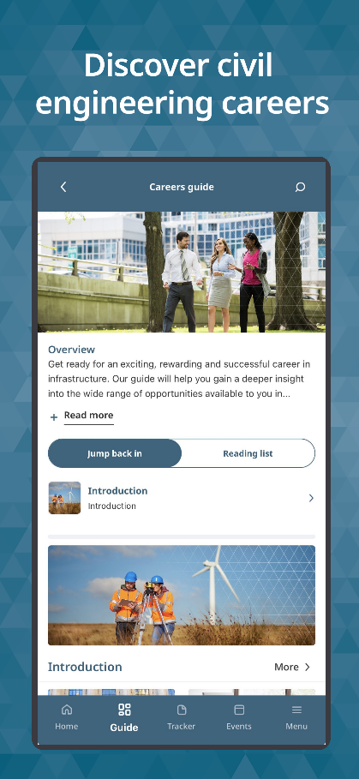
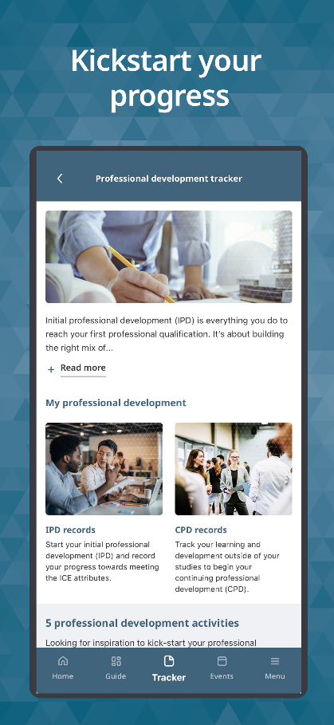
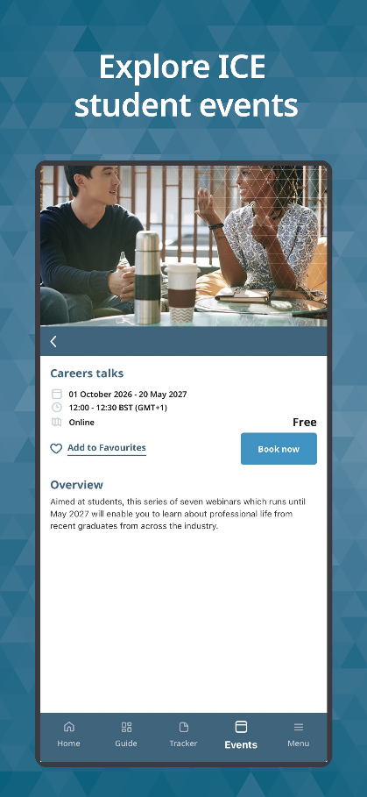
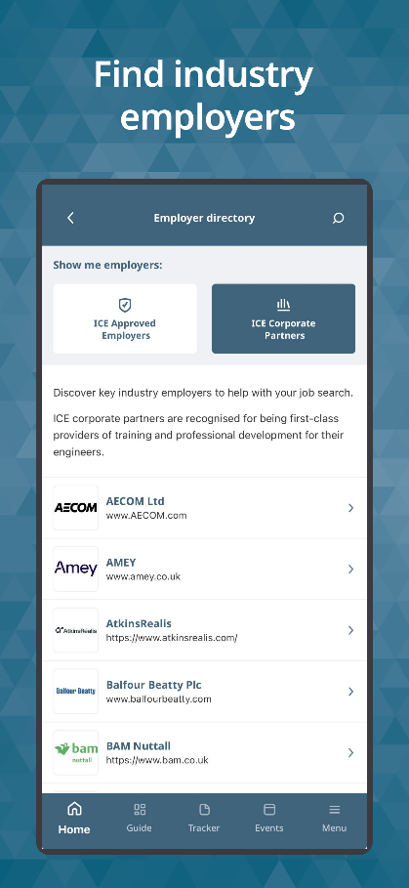
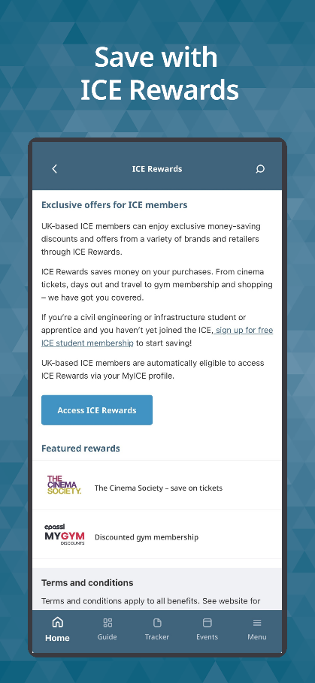
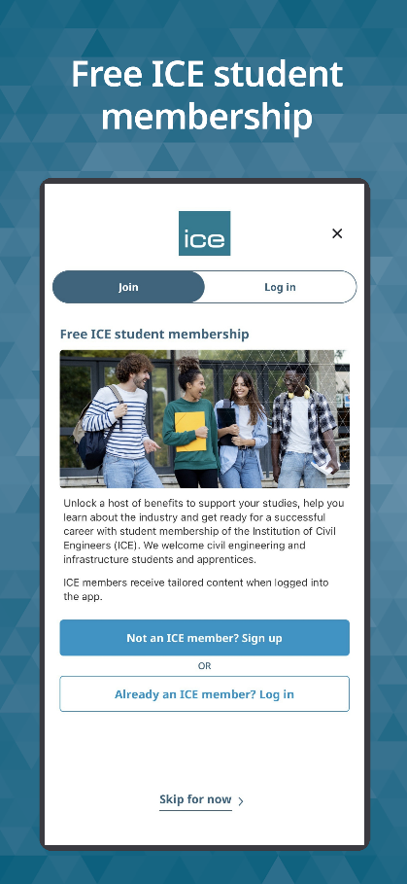
ICE Careers app: careers guide, tracker, events and more
Tracker:
Exclusive access for ICE Student Members
ICE Rewards: Exclusive access for ICE Student Members
Notes:
ICE Careers app – key features and content
Careers guide. Features industry insights, sector overviews, role profiles and career pathways
Guide also showcases real-world case studies of the people and projects shaping the industry
Professional development tracker. Students can begin to record their professional development (IPD and CPD) to get a head start on their journey to become professionally qualified
App also features ICE events for students, ICE Rewards offers, employer directory and more
All students can download the app. ICE Student Members can log in to the app to access additional features: the professional development tracker, ICE Rewards, also favourite events, save content from the guide and other tailored content.

Slide 16
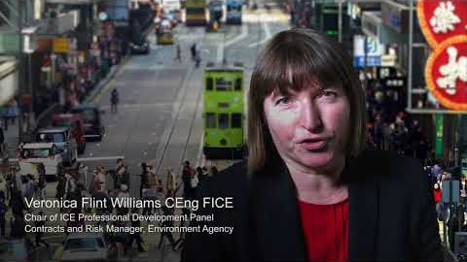
Notes:
TOPIC: VIDEO HIGHLIGHTING BENEFITS OF ICE MEMBERSHIP AND QUALIFICATIONS
*PRESENTER NOTE: video requires online link. For good sound, recommend testing sound equipment ahead of presentation if possible*
Introduce video – hear why our members and employers, think that ICE membership and professional qualifications are so vital to their careers.
Video on the slide is at this link (shorter version, 03:30) - https://www.youtube.com/watch?v=hSOstb3n5O0

Slide 17
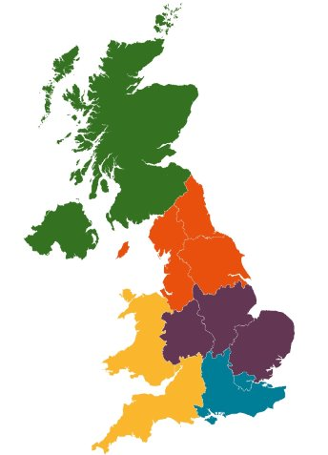
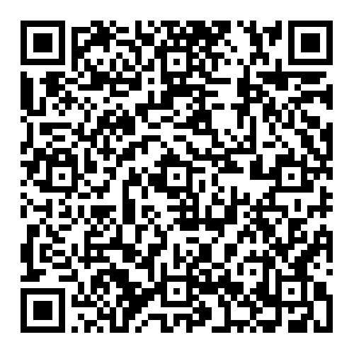
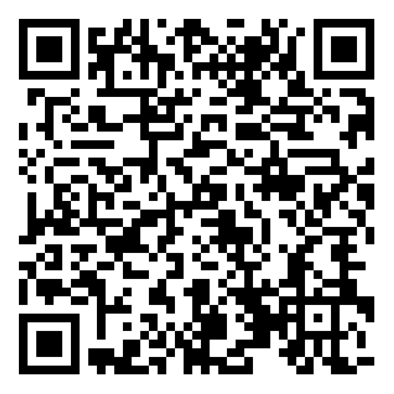
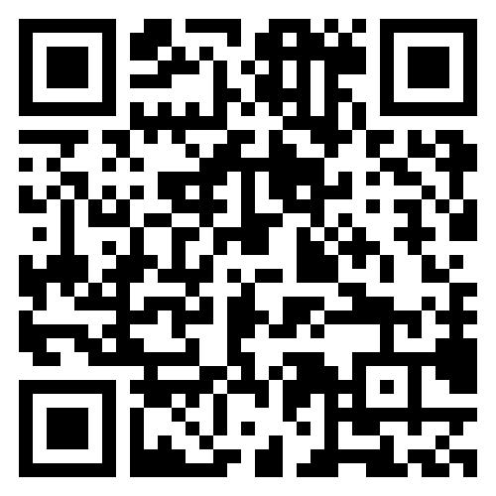
Here to support you
Membership support
ice.org.uk/membershipguidance
+44 (0)121 227 5948
membershipsupport@ice.org.uk
Professional qualification training
ice.org.uk/pqt
ICE online resources
ice.org.uk/near-you
Notes:
TOPIC: ICE IN YOUR AREA
*PRESENTER NOTE: either keep Membership Support Centre details, or replace with your own contact details for membership support.*
ICE has local teams and volunteers, across the UK and around the world, who support with membership queries, arrange events and activities.
Once you begin your career journey, our team of Membership Managers and Membership Development Officers (MDOs) offer support and guidance on your path towards becoming qualified.
You can get in touch with your local representative through our Membership Support Centre.
We offer a range of locally delivered workshops across the UK, to give advice and guidance to help you on your way to professional qualification.
There is also a wealth of webinars available on the ICE website – you can join them live, or watch recordings anytime.
And of course this is all in addition to the support and guidance you’ll receive from your employer and your SCE, DE or mentor.

Slide 18

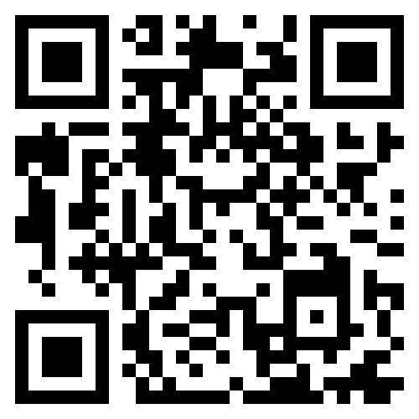
Join the world's leading
civil engineering institution
Start your career journey - become an ICE Graduate Member
Apply online ice.org.uk/graduates
Notes:
TOPIC: FINAL CALL TO ACTION SLIDE
*PRESENTER NOTE: Key aim is to get final year students to sign up for graduate membership*
Summarise what you have covered in your presentation:
Why and how to transfer onto graduate membership
Becoming professionally qualified and why it is so important to your career
What you can do now to start your progress towards professional qualification
How ICE will support you throughout your career
Next steps
Key call to action: When you complete your studies, upgrade to graduate membership at ice.org.uk/graduates
You will then be entitled to use GMICE postnominals after your name which enhances your CV and is great for job applications.
Secondary calls to action:
Get involved: make the most of your membership, come to events, meet other members.
The next step will be to start formally recording your professional experience and learning – or initial professional development (IPD) and continuing professional development (CPD). You might already have started this while at the University on placements or with summer work experience.
(Refer back to slides to remind on other key actions now e.g. enrol on Training Scheme, register with IPD Online)
Make sure to follow the ICE on social to keep up to date on news and events.
Good luck with your journey to professional qualification: keep the end goal in sight, and don’t forget that support is always available.

