Slide 1


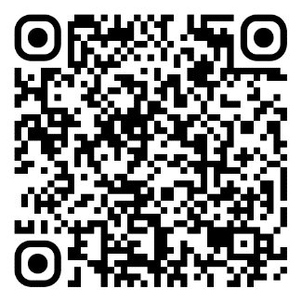
ICE student membership: IPD for students
Join the world's leading civil engineering institution
Notes:
INTRO SLIDE
IPD stands for Initial Professional Development. It’s the stage where you start building the knowledge, skills and experience needed to become a professionally qualified civil engineer with the Institution of Civil Engineers.
Even as a student, you’re already gaining valuable experience—through coursework, placements, internships, or volunteering—that can count towards your IPD. By recording it early, you’ll save time later, track your progress more effectively, look professional at job interviews and be better prepared when you apply for professional qualification.
Think of it as building your professional story from day one.

Slide 2
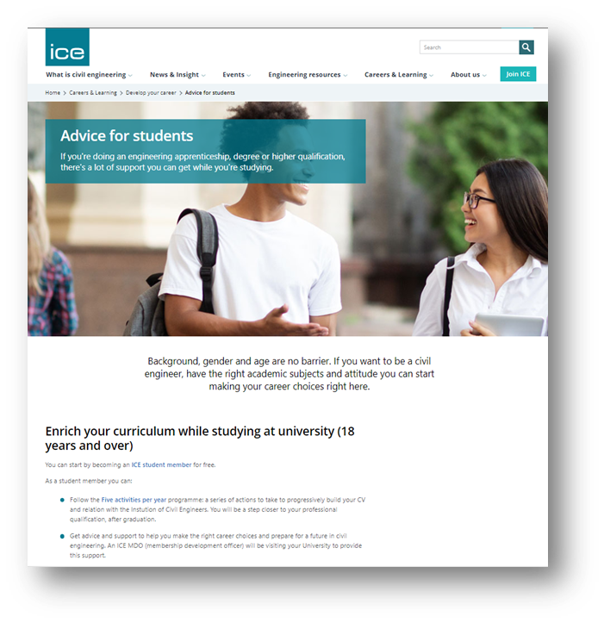
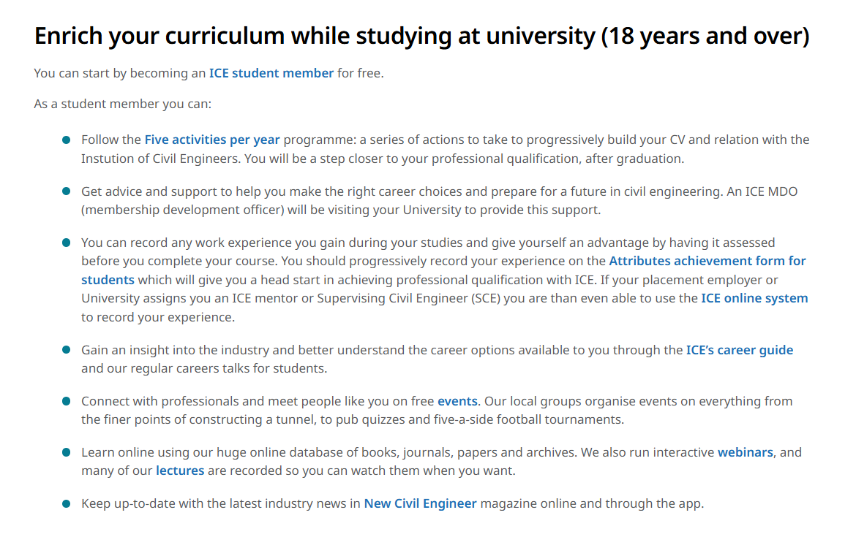
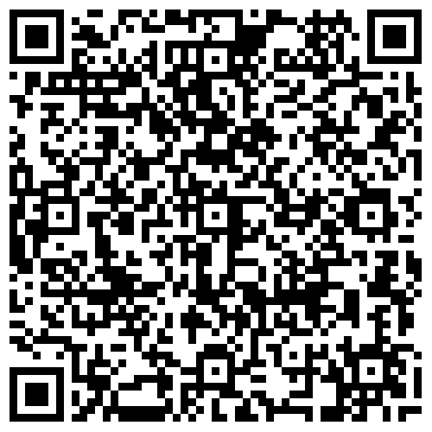
Enrich your curriculum while studying at university
ice.org.uk/advice-for-students
Notes:
On this slide, you'll find the webpage dedicated to advice for students to enrich their curriculum and start their professional development.
The first link on this key webpage is ‘5 activities per year’ which contains some easy suggestions as you progress.
If you're a Student Member of the ICE, you can already begin tracking your professional growth using the Attribute Achievement Form.
It’s a simple tool made just for students to log experiences outside your degree—like internships, site visits, or volunteering.

Slide 3
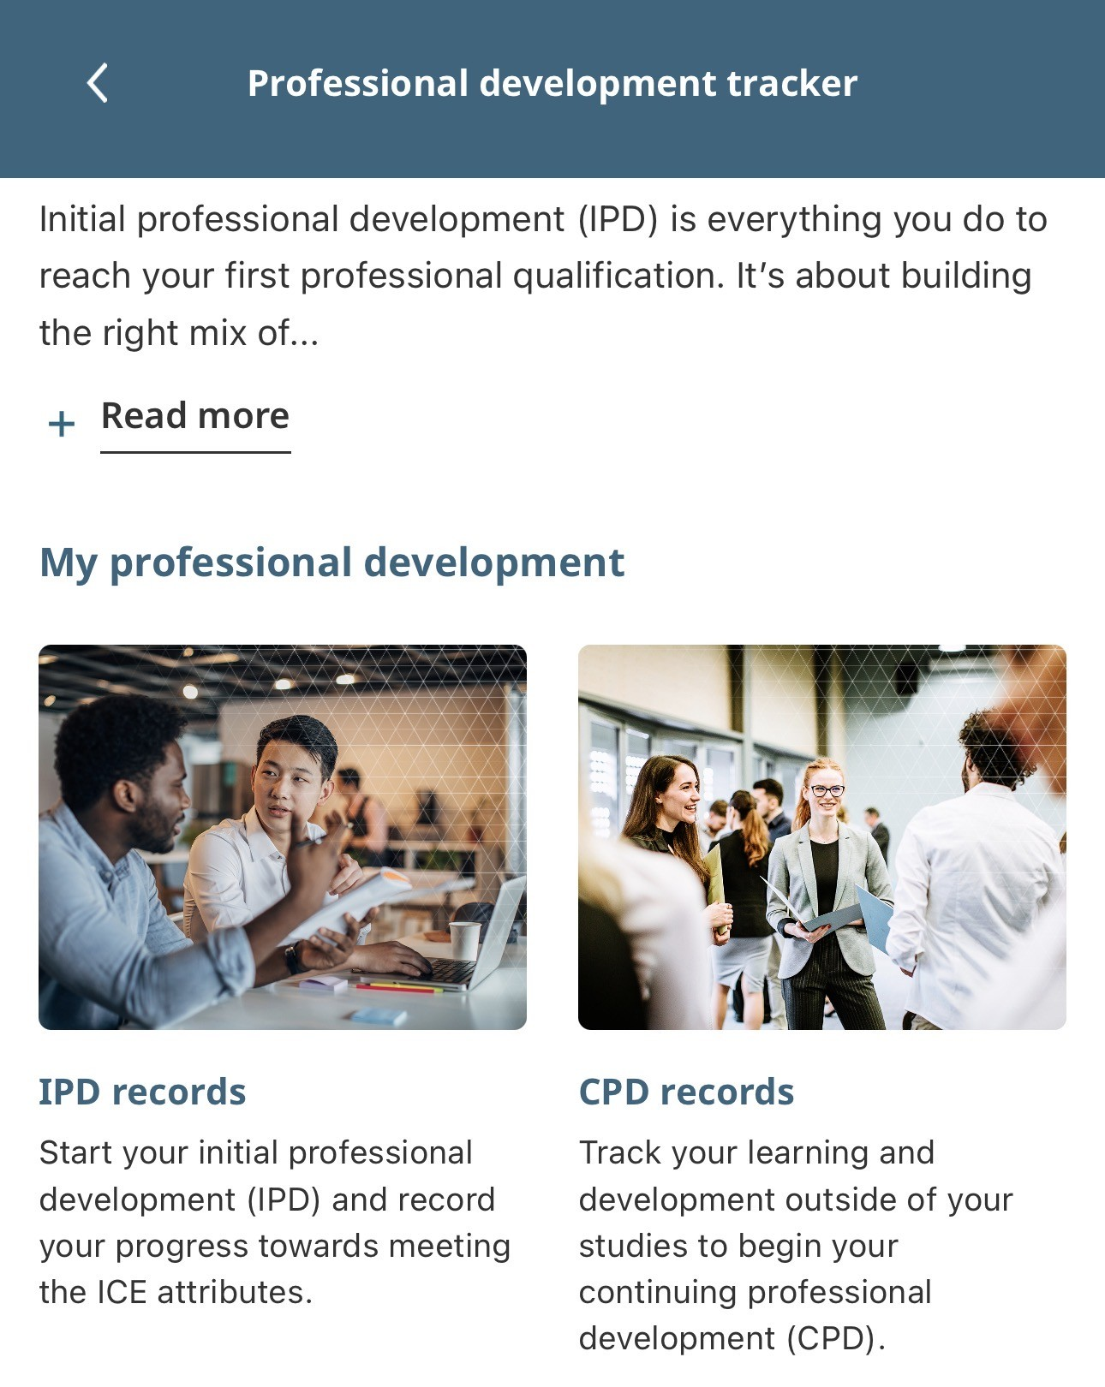
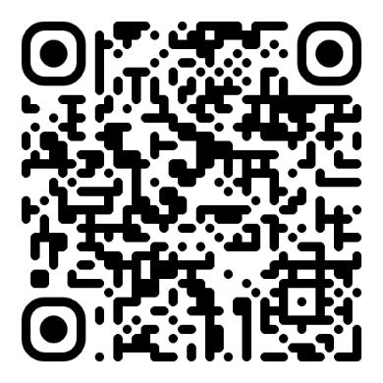
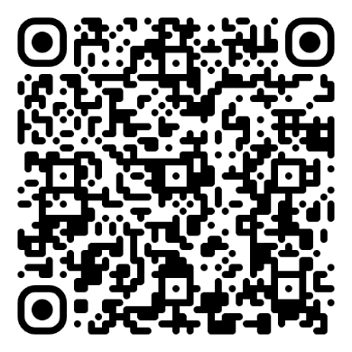
Make your experience count: record it
ICE Careers app – Tracker tool:
It all counts towards your progress to professional qualification:
Summer jobs
Volunteering projects
Placements
Student body roles
Casual work
iOS
Android
Download the ICE Careers app to record your experience on the Tracker tool. Or download and record your experience using the Attribute Achievement form.
Notes:
TOPIC: RECORDING YOUR EXPERIENCE
If you have gained work experience during your studies, you can record it and gain a head start on your journey to professional qualification with the ICE.
If you have had a regular placement with a civil engineering employer, you probably have more.
ICE Careers app – Tracker tool
Download the ICE Careers app and begin recording your initial professional development (IPD) and continuing professional development (CPD) using the Tracker tool.
Attribute Achievement form
You can also record your experience using the Attribute Achievement form available for download on the ICE website linked on this slide.
For each attribute:
Write bullet points showing what you’ve done outside your coursework (e.g., internships, volunteering, site visits).
Reflect on how each activity helped you grow professionally.
Discuss your progress with someone – a peer, tutor, or mentor.
If you don’t have a mentor, that’s okay.
The key is to start recording. You will start the discipline that usually graduates have once in full-time employment.
Next, we’ll look at real examples from student experiences.
It’s a great way to stay ahead, show your commitment to employers and make your future IPD journey much easier.
You will note that all bullet points make suggestions towards activities that are over and above your degree requirements.
If you do not have evidence for each attribute now, don’t worry. As you gain more experience, you will gain more evidence for each of the attributes.

Slide 4
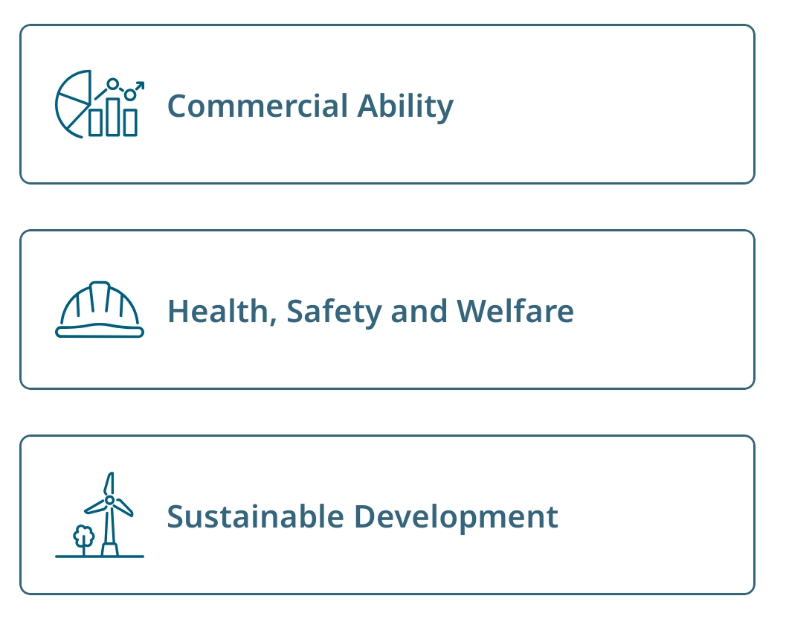

Start recording your initial professional development (IPD)
7 Attributes
CPD
CPD
Attribute achievement records
Development action plan (DAP)
Personal development record (PDR)
Notes:
You can start recording your Initial Professional Development (IPD):
Attributes Achievement Form – there are 7 attributes that professionals measure themselves against and they are usually used on an online system (IPD Online). The version we will show you in this presentation is designed for students. It helps you log what skills and knowledge you’re gaining as you go. Think of it as your personal progress tracker.
PDR (Personal Development Record) – This is the first one of two records to track your Continuing Professional Development (CPD), like events, training, or learning outside your degree. All ICE members need to keep CPD records.
DAP (Development Action Plan) – This helps you plan what you want to learn next. It’s a great way to stay focused and set goals for your development.
In this presentation we will illustrate these records.

Slide 5
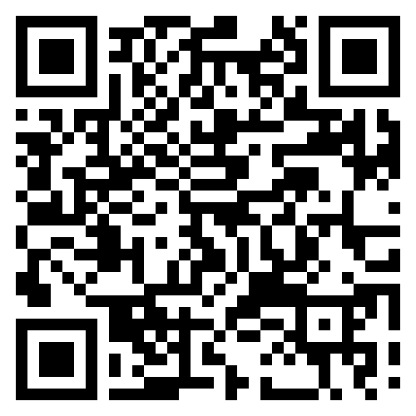
The seven ICE attributes
1. Understanding and Practical Application of Engineering
2. Management and Leadership
3. Commercial Ability
4. Health, Safety and Welfare
5. Sustainable Development
6. Interpersonal Skills and Communication
7. Professional Commitment
View full details of the ICE attributes:
ice.org.uk/attributes
Notes:
These are the 7 criteria that ICE uses to measure competence.
They are very intuitive.
Understanding and Practical Application of Engineering: Demonstrate deep knowledge of engineering principles and their practical use.
Management and Leadership: Plan, manage, and lead engineering tasks and projects effectively.
Commercial Ability: Understand and apply commercial and financial principles in engineering contexts.
Health, Safety, and Welfare: Prioritize and ensure the health, safety, and welfare of all stakeholders.
Sustainable Development: Promote and implement sustainable practices in engineering projects.
Interpersonal Skills and Communication: Communicate effectively and work collaboratively with diverse teams.
Professional Commitment: Show dedication to continuous professional development and ethical practice.
As students, you can start using the same set of examples from your student life. While these may not carry much weight during your future professional review, starting now gives you a head start.
You'll become familiar with the ICE system before entering the professional world, allowing you to seek and identify support for your future progress, regardless of the level of structured support available.

Slide 6
Example: Attribute 1 – Knowledge and practical application of engineering
“During my summer job, I was tasked with designing a 3x4m concrete slab. I proposed two options: one reinforced concrete (RC) and one using precast elements, comparing their pros and cons.”
Notes:
This is a great example of how your experiences outside the classroom can demonstrate your growing engineering knowledge.

Slide 7
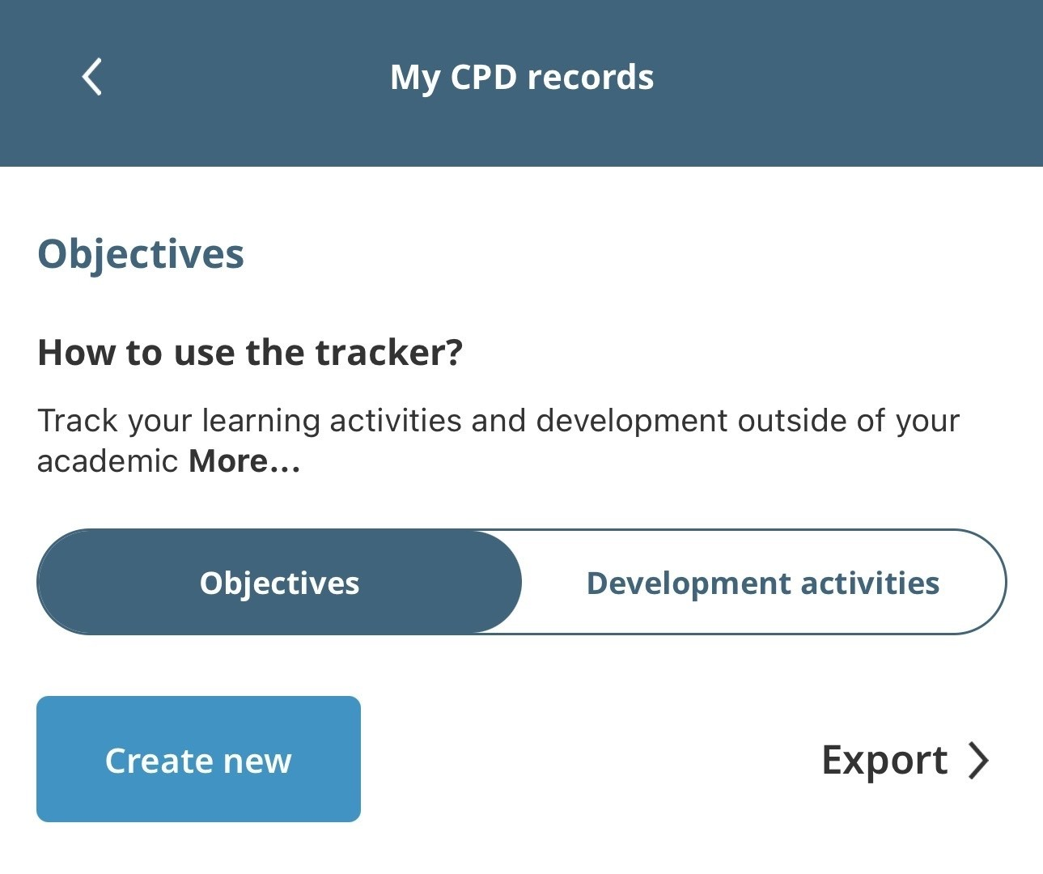
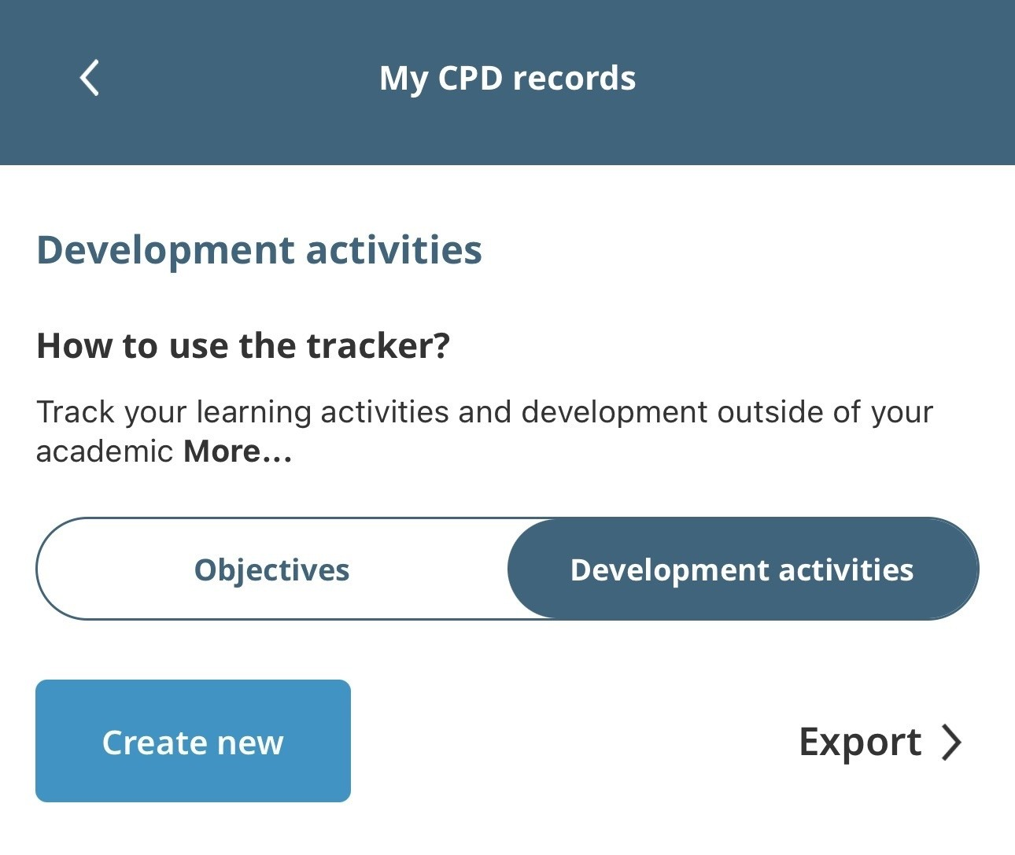
Continuing professional development (CPD): DAP & PDR
ICE Careers app: Objectives
ICE Careers app: Development activities
Development action plan (DAP)
Personal development record (PDR)
Notes:
As a Student Member of the ICE, you can start building your professional development record using the ICE Careers app Tracker tool.
Development Action Plan (DAP)
Use this to set goals for your learning and development.
Think about what skills or experiences you want to gain—like attending a site visit, improving presentation skills, or learning about sustainability.
Update it regularly as your goals evolve.
Personal Development Record (PDR)
Use this to log what you’ve done—lectures, placements, volunteering, or events.
Include the date, a short description, and what you learned.
This helps you reflect on your progress and prepare for future job applications or ICE membership.
You will be expected to keep these records as a professional. All professional bodies require it or expect it.

Slide 8
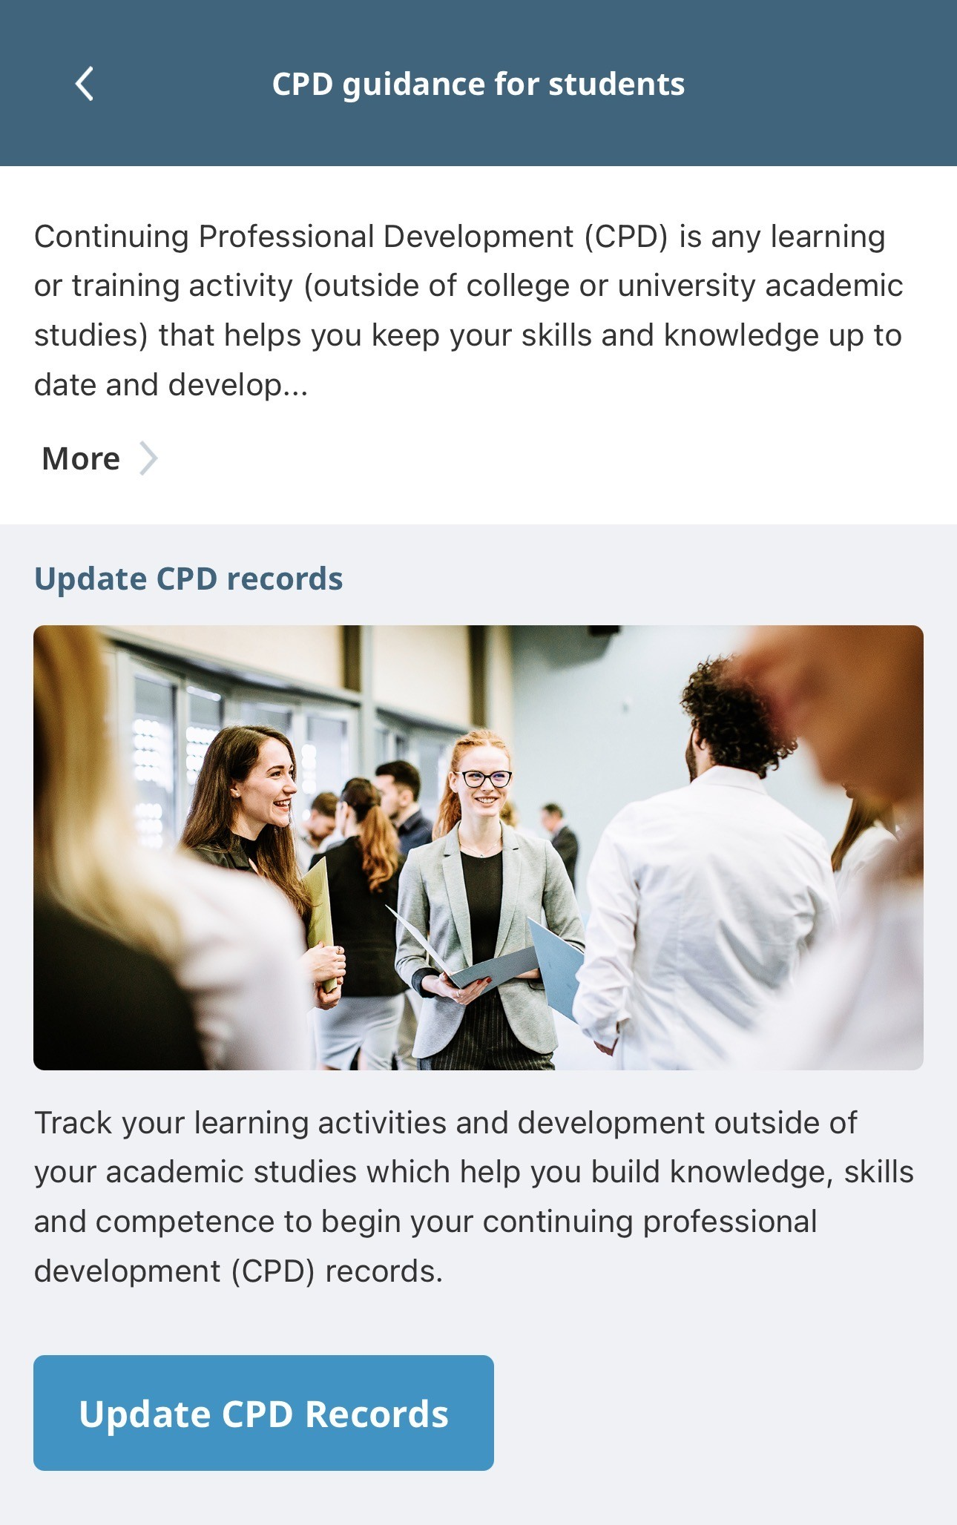
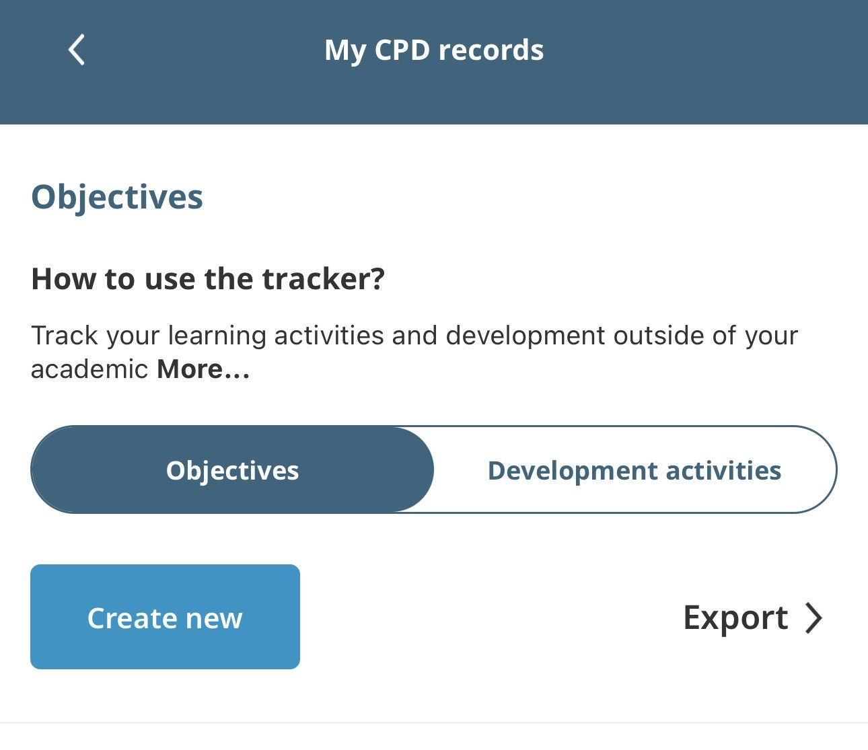
CPD records for students
ICE Careers app – CPD:
iOS
Android
Notes:
As a Student Member of the ICE, you can start logging your Continuing Professional Development (CPD) now.
Scan the QR codes on this slide to download the ICE Careers app and begin recording your CPD using the Tracker tool.
Use it to record lectures, site visits, volunteering, or any learning outside your degree. Anything you think you have learned something from: as long as you can describe what it is that you have learned and how you have benefited!
It’s a great way to build good habits and show your commitment to professional growth.

Slide 9
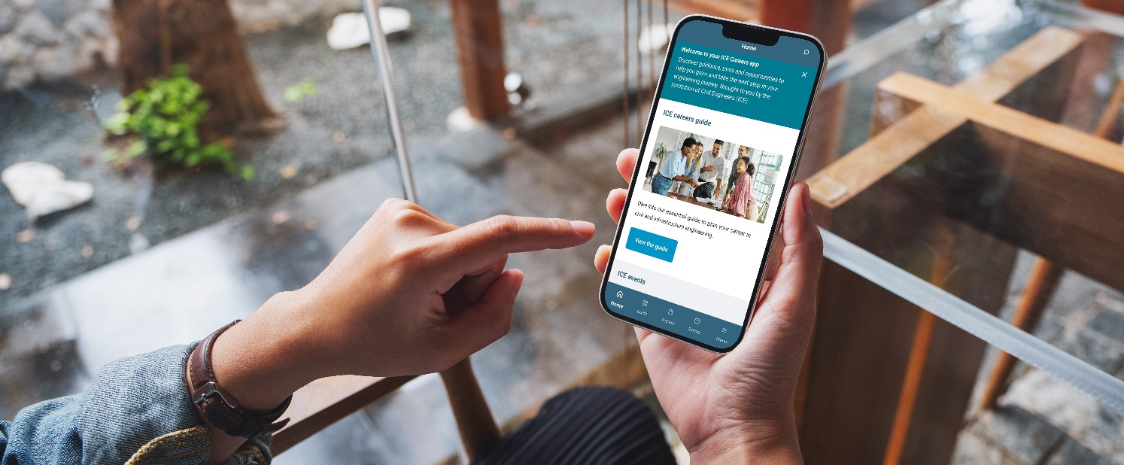

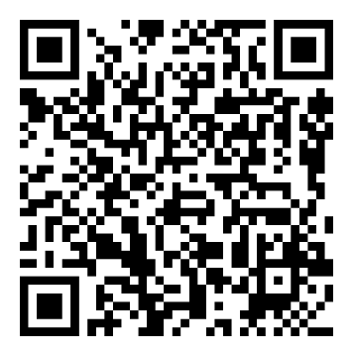
Your guide to getting ahead
ICE Careers app
Careers talks
Get career ready. Explore our careers guide, track your development, discover ICE student events and more. Download the app.
Get industry insight and practical tips from recent graduates through our webinar series.
iOS
Android
Notes:
TOPIC: YOUR GUIDE TO GETTING AHEAD
Stay ahead of the curve by taking advantage of opportunities to learn about the industry and prepare for a successful career in civil engineering.
Careers talks
Regular, approx. monthly online talks. Recent graduates share their experience, industry insight and top tips.
Featuring graduates from a range of sectors, employers and previous universities.
Engaging talks – watch live online or view recordings.
ICE Careers app
Mobile app designed to help undergraduate students and apprentices plan their career in civil engineering and infrastructure
Features a careers guide, professional development tracker, ICE events and more support for students
Download the app – QR codes on slide, or search ‘ICE Careers’ in Apple App Store or Google Play
(Speaker note: more detail re app is on speaker notes on following slide with screenshots)

Slide 10
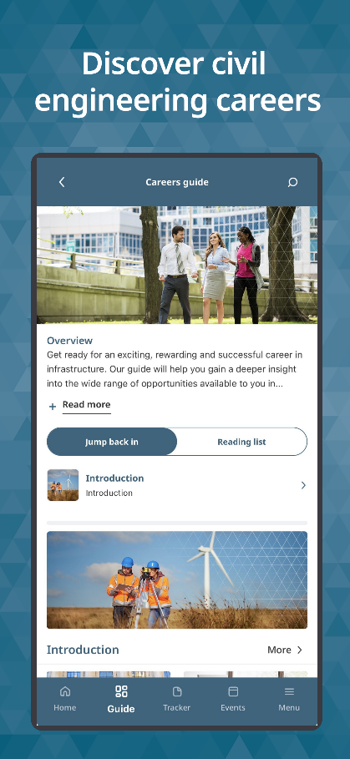
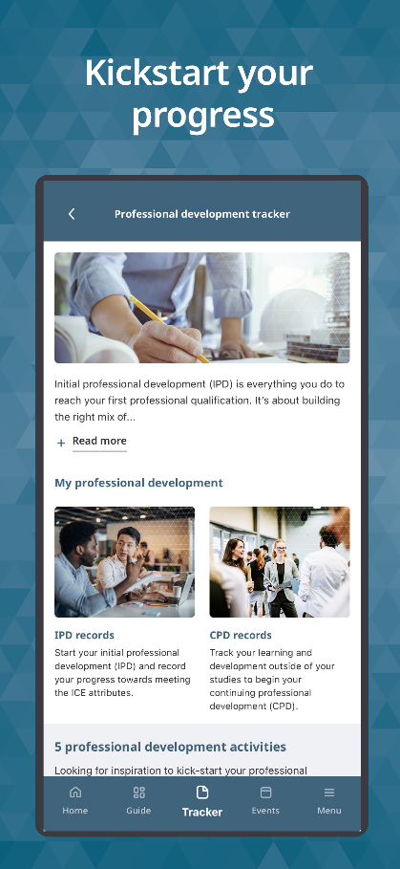
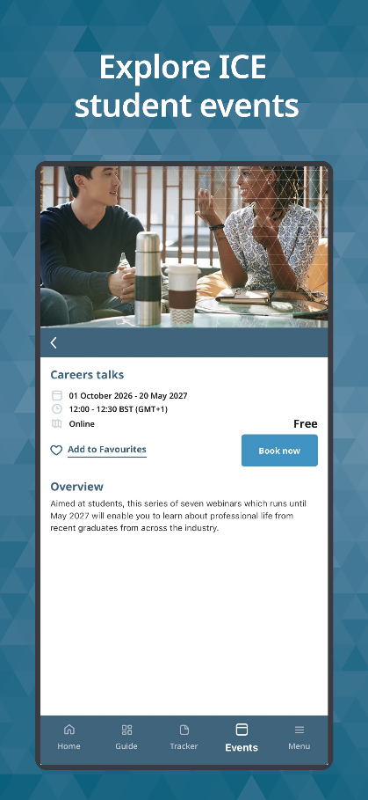
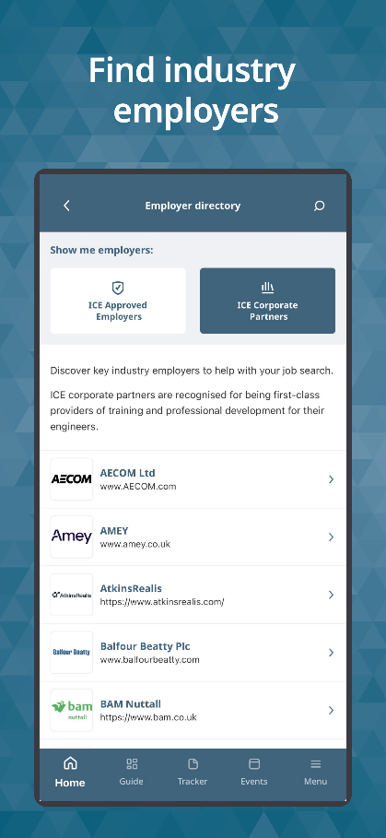
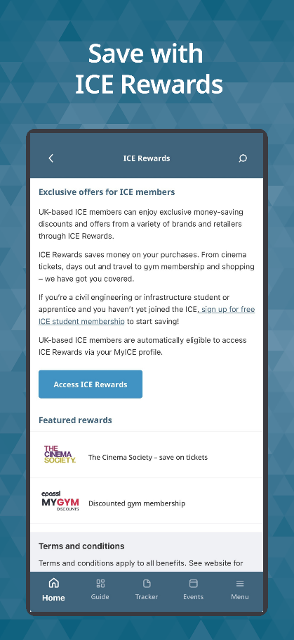
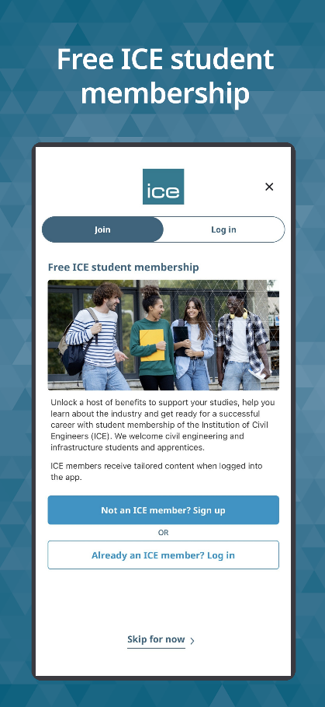
ICE Careers app: careers guide, tracker, events and more
Tracker:
Exclusive access for ICE Student Members
ICE Rewards: Exclusive access for ICE Student Members
Notes:
ICE Careers app – key features and content
Careers guide. Features industry insights, sector overviews, role profiles and career pathways
Guide also showcases real-world case studies of the people and projects shaping the industry
Professional development tracker. Students can begin to record their professional development (IPD and CPD) to get a head start on their journey to become professionally qualified
App also features ICE events for students, ICE Rewards offers, employer directory and more
All students can download the app. ICE Student Members can log in to the app to access additional features: the professional development tracker, ICE Rewards, also favourite events, save content from the guide and other tailored content.

